Slide 1
Machine Learning on Medical Application: Retained Surgical Instruments
Richard Chan (chanrich@usc.edu)
Faculty Advisor: Professor Raghavendra
Department of Electrical Engineering
University of Southern California
2016 Spring

Slide 2
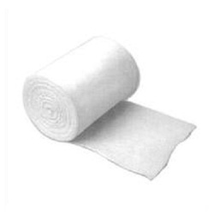
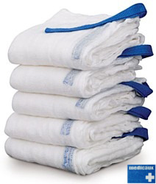
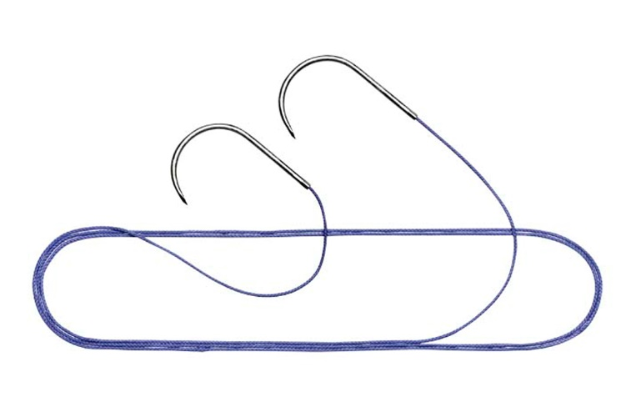
Introduction
Problem:
Retained Surgical Instruments
Sponges, Towels, Needles, Soft/Sharp objects
Harmful, can be deadly
Solution:
Counting
10%-15% error rate
X-ray to radiologist
67% success rate
Notes:
New topic Retained Surgical Instruments where surgical items left inside body.
If left inside body unnoticed, the patient will suffer and can be deadly
Mainly deal with sponges and cotton strings.
There are few techniques to solve this problem.
Counting, where surgeon counts the items before and after the surgery. The estimated counting error rate is 10-15%.
Newer techniques are X-ray imaging. X-ray scan are captured before surgeon sew up the body and send to radiologist for immediate check.
The respond from radiologist only have 67% accuracy. Due to reason like experience, unfamiliarity with instruments.

Slide 3
Background
RSI cases: around 1500-2000 cases per year in U.S.
Retained Surgical Sponges is the most common
X-ray post-surgery scan is a prominent solution
Surgeons send image to radiologists
Need faster and accurate respond
Apply machine learning
Massachusetts General Hospital - Harvard Medical School
Initially, provided 50 patients X-ray scans with sponges, to train software
Another 200 scans, with or without sponges, to verify accuracy.
Notes:
There are many cases of this kind of incidents, and they are mostly sponges problem
X-ray imaging is one possible solution to this problem but require higher accuracy.
I am going to apply machine learning on those images to solve this problem.
Initially I have 50 x-ray scans from Harvard. After I trained the program with these 50 images, I can proceed to request another 200 images for verification.

Slide 4
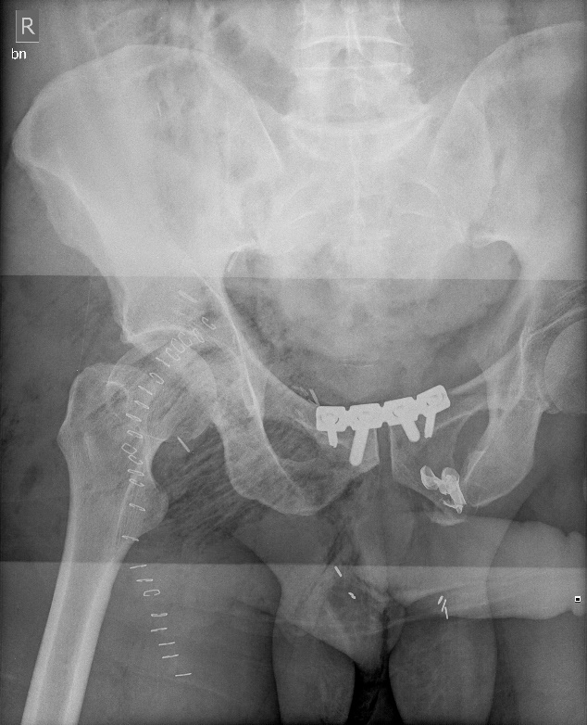
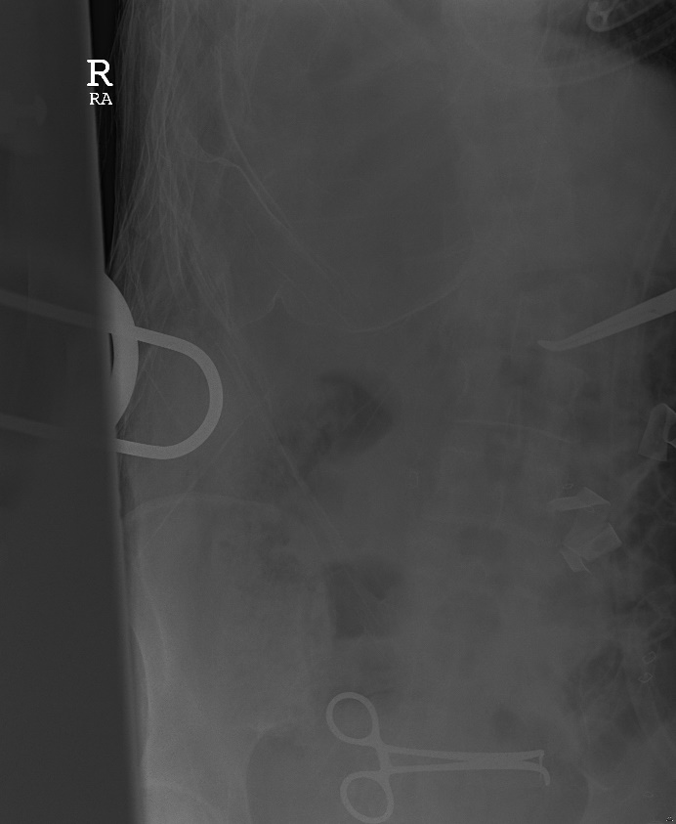
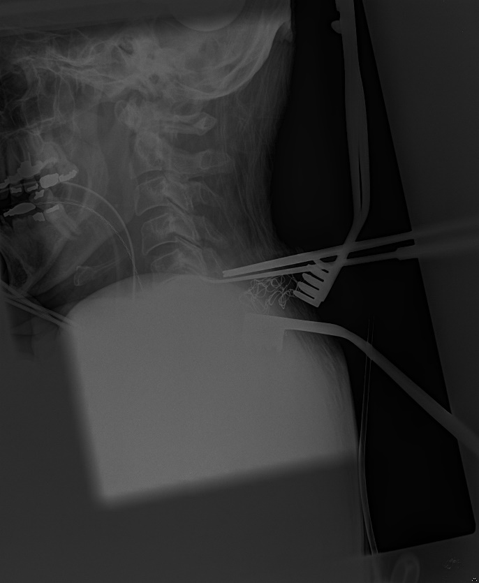
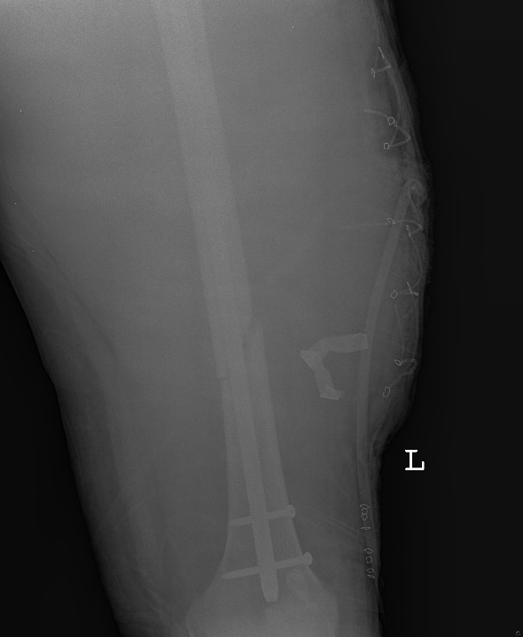
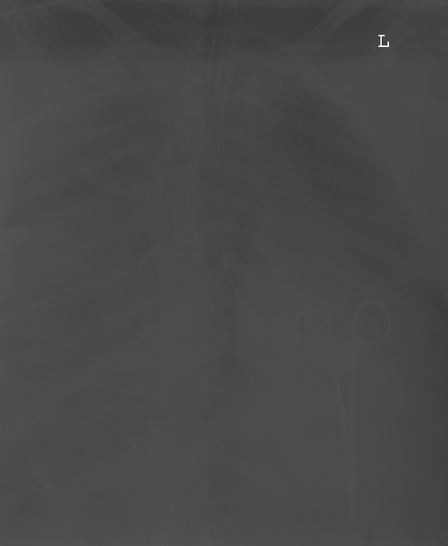
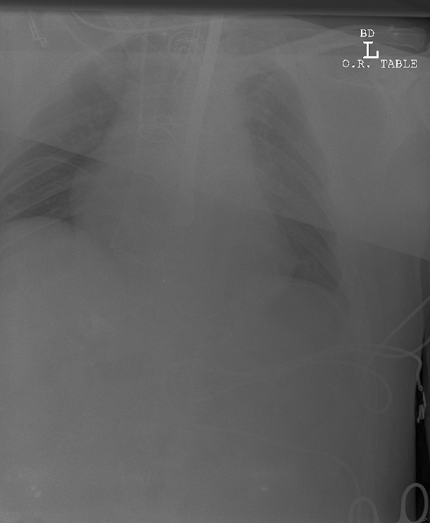
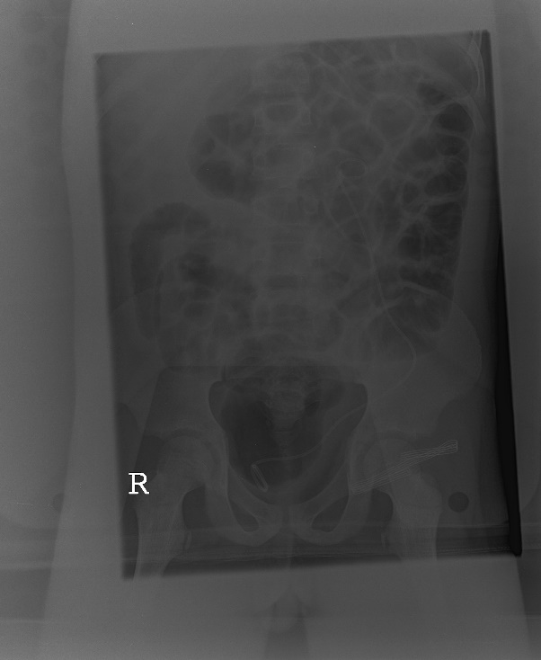
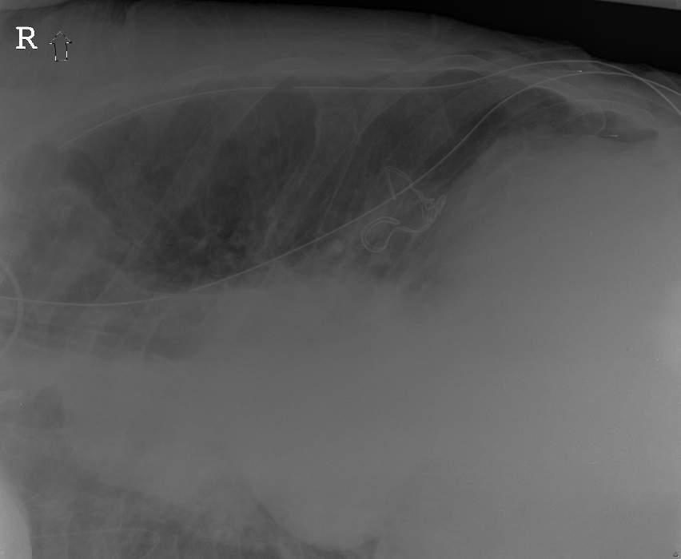
Notes:
Original images from Harvard.
Determine if there is sponges, cotton wires or not.

Slide 5


My approach
Extract ground truth from 48 X-ray images.
Contour extract with Canny edge detector and Laplacian Operator
Feature detection and matching using contour.
Notes:
Since all images are unique, I think performing contour matching will be a solution to this.
My approach is to extract key images from 48 images and then process them with canny or Laplacian to get contours.
These contour becomes ground truths and my program uses them to determine existence of sponges.

Slide 6
Research Methods
Phase 1
Image Pre-processing
Normalization
Contrast adjust
Gaussian Blur
Create False Case
Duplicate x-rays and remove key objects with Photoshop.
Ground Truth Extraction
Extract key objects from all 48 X-rays.
Contour Extraction
Canny Edge Detector
Laplacian Operator
Notes:
Pre-process the images to make it more readable for both machine and human.
Normalization to equalize the histogram.
Adjust control to make detail more appearant.
Blur images increase the chances of finding a match.
Since I only have True cases, all the images contain sponges. I will need to create some false cases.
I used photoshop and remove the key objects before I save it as new false case image. I just insert an x into the filename so my program know this is a false case
I also extract all key objects and put them on to one image, this image will be my ground truth.

Slide 7
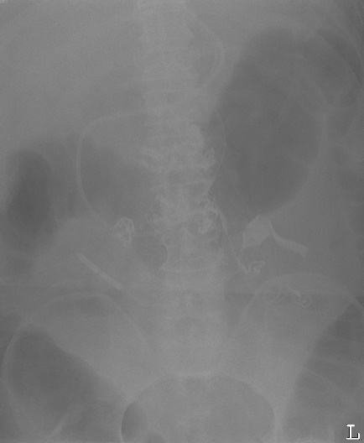
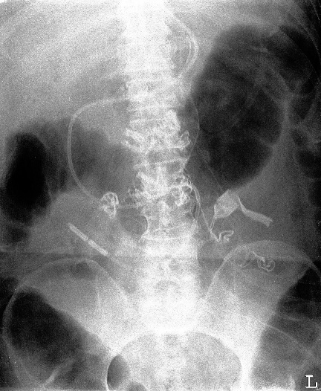
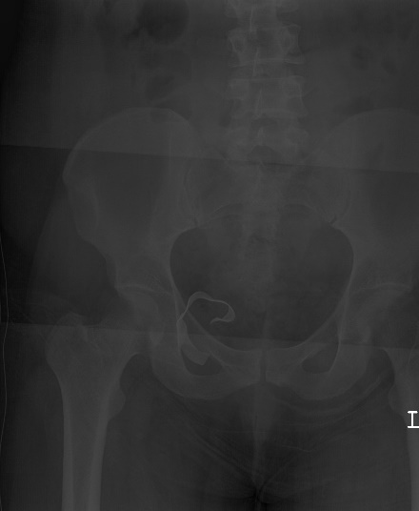
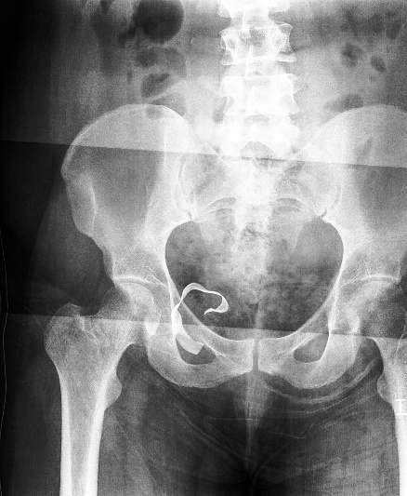
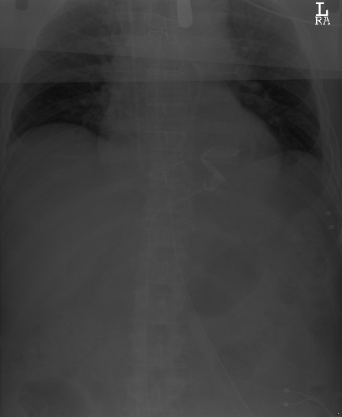
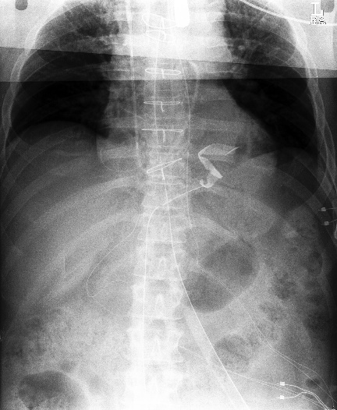

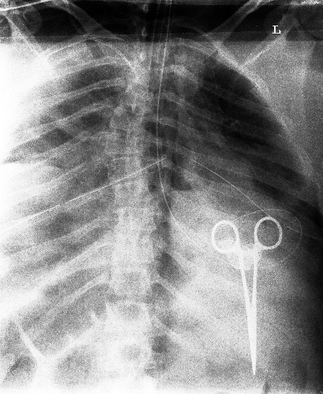
Normalization
Equalize histogram.
Original Normalized
Original Normalized
Notes:
This make the image more readable.
We can easily locate the sponges even with human eye.

Slide 8

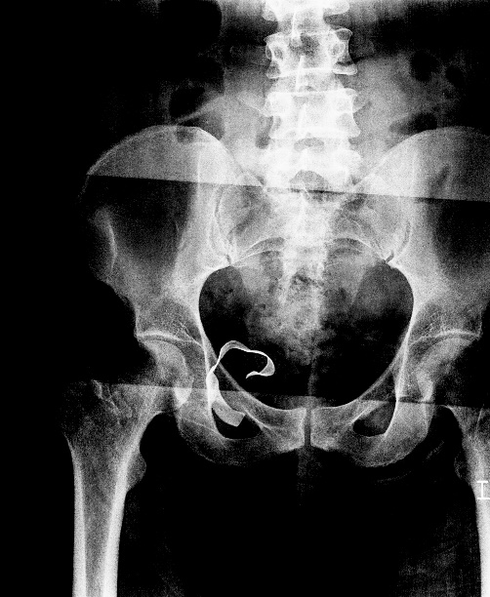
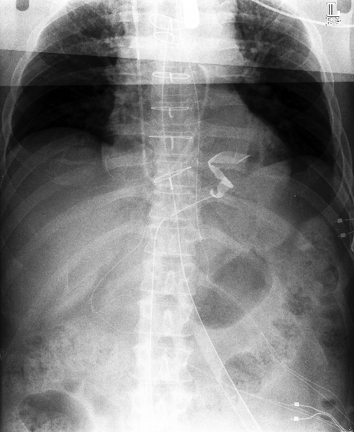
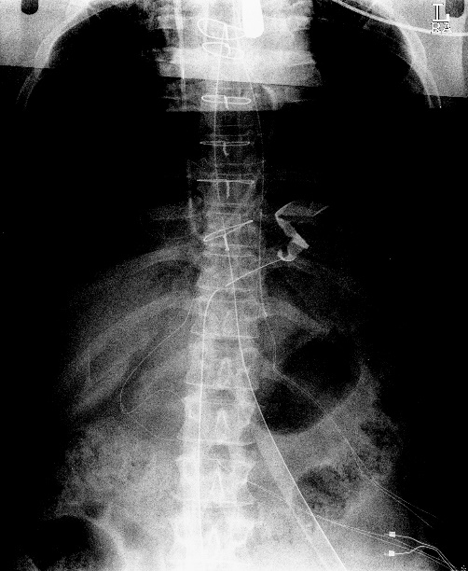
Contrast Adjust
Remove Unnecessary information
Increased contrast = more feature points around key regions
Notes:
Adjusting contrast will filter out unnecessary background. The idea here is to filter out as much background as possible without removing our region of interest.

Slide 9
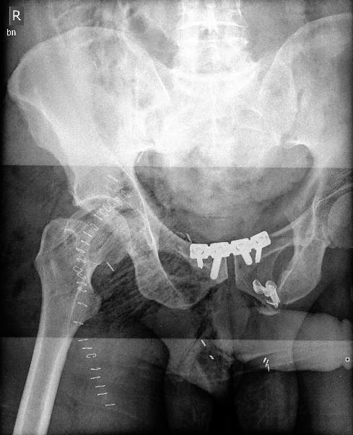

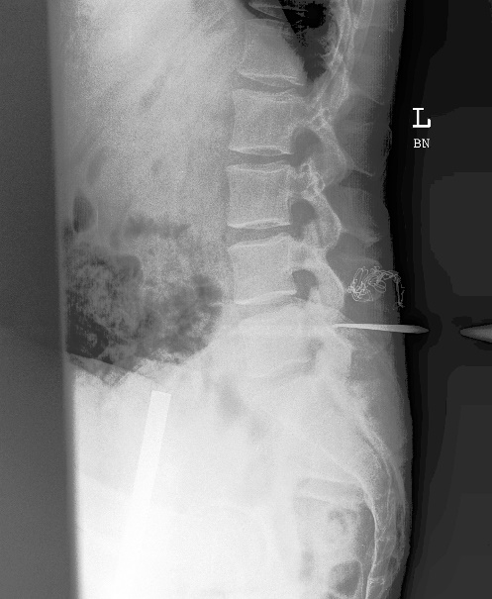
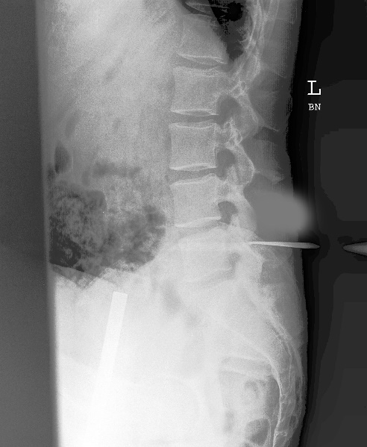
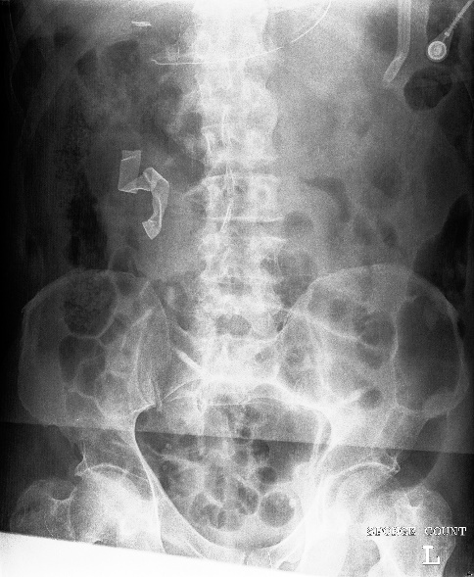
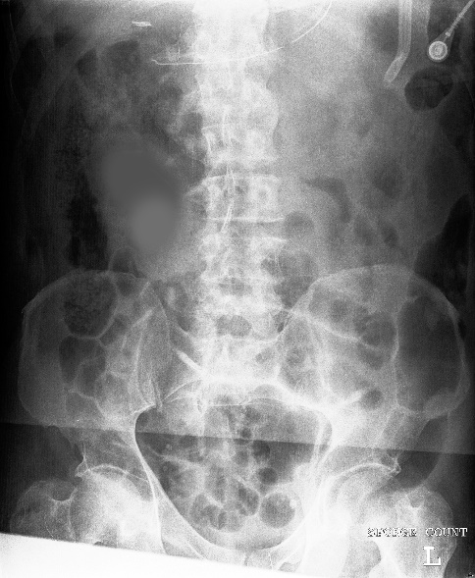
Create False Case
Learn false key points
Notes:
False cases are images with key area removed.

Slide 10
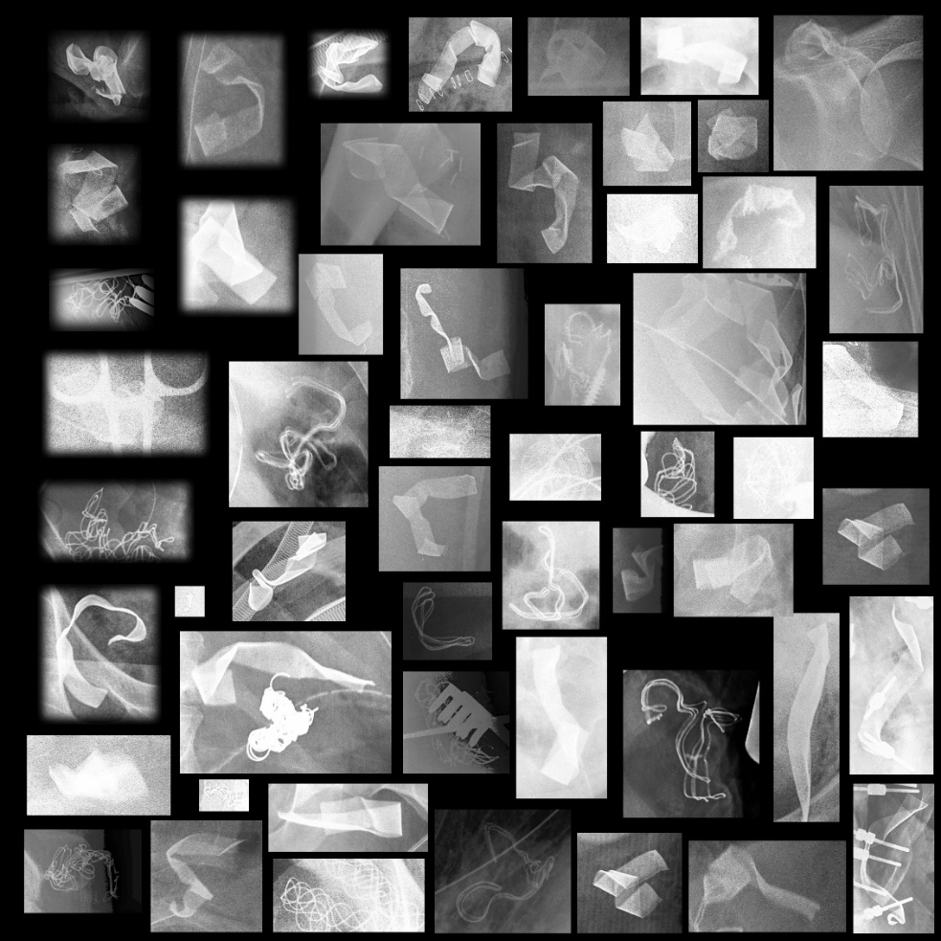
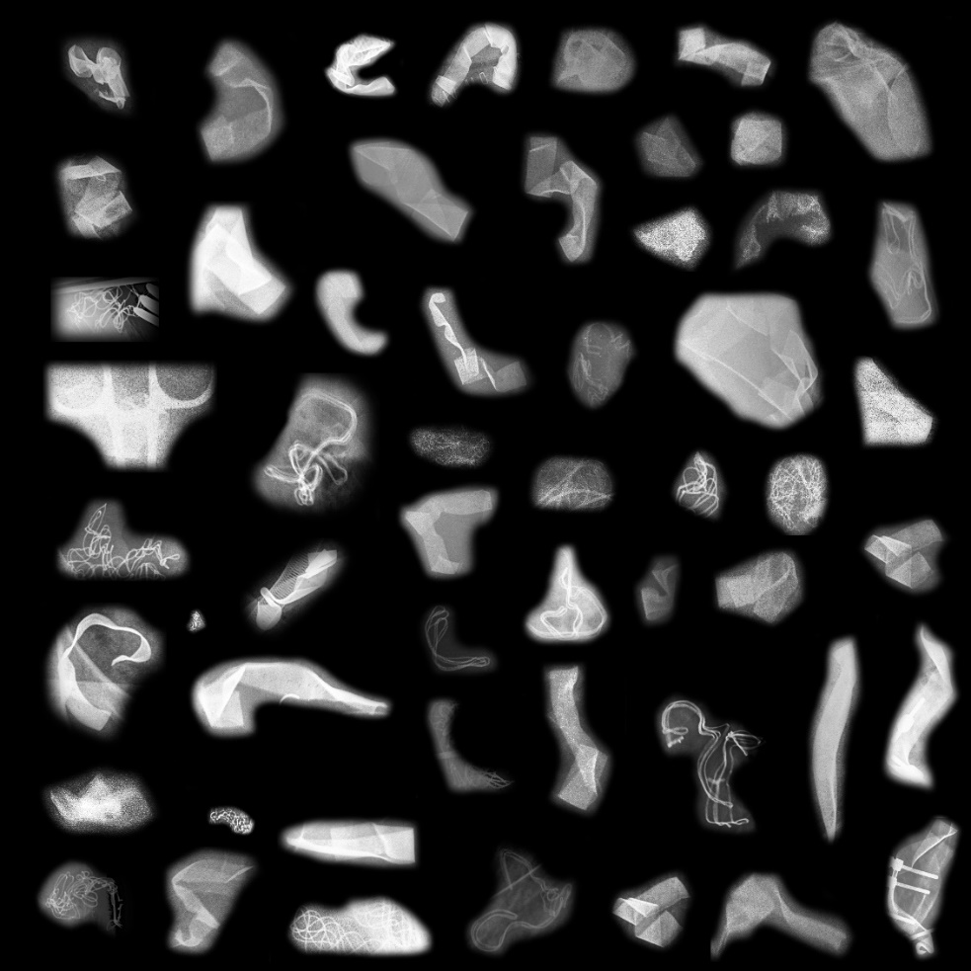
Ground Truth Extraction
Extract key region from all X-ray scans
Reduce unnecessary border information
Squeezing produce a lot of incorrect border information
Notes:
Here I extracted key object from all images and put them onto one image.
Second picture I reduce too much information and the result were very poor.

Slide 11
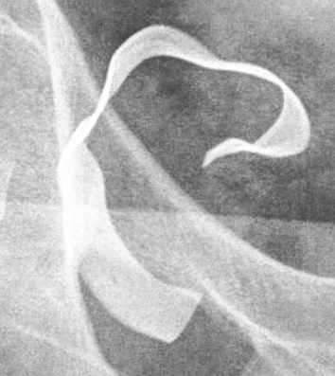
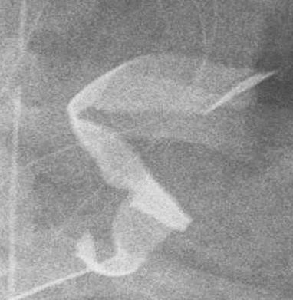
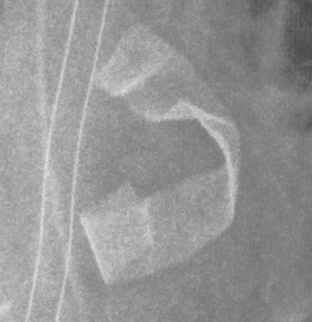
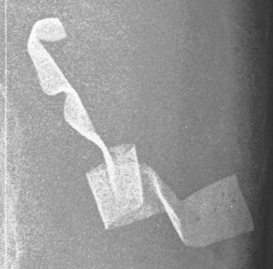
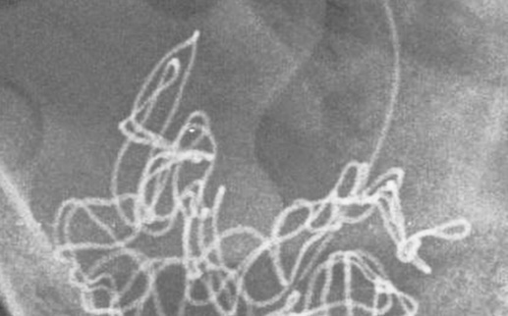
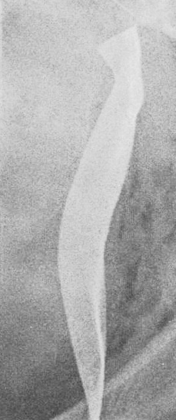
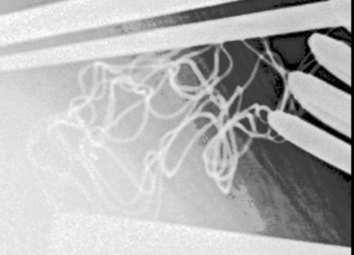
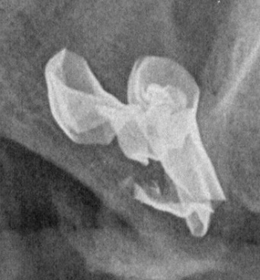
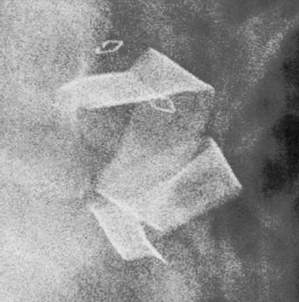
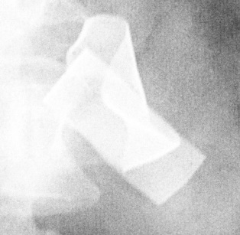
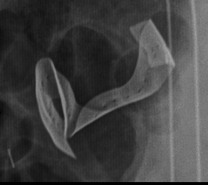
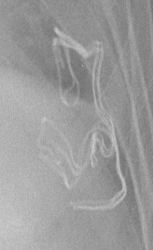
Ground Truth Extraction
Better Method
Produce separate images for each ground truth
Effectively remove all border edges
Notes:
A better way to extract ground truth.
This method effectively eliminated all unwanted border cases.

Slide 12
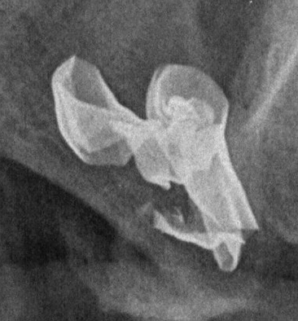
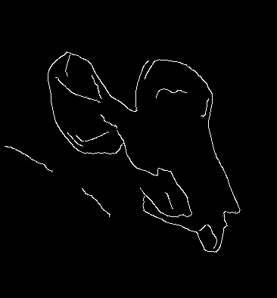
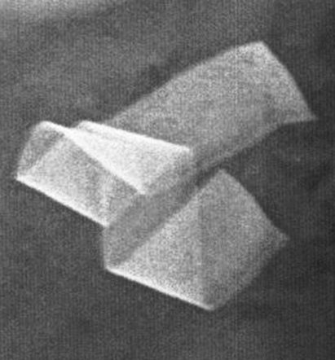
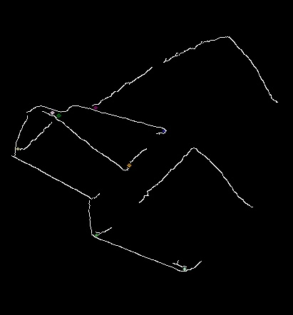
Canny Edge Detector
Apply Gaussian filter to smooth the image in order to remove the noise
Find the intensity gradients of the image
Apply non-maximum suppression to get rid of spurious response to edge detection
Apply double threshold to determine potential edges
Track edge by hysteresis
Notes:
Developed in the 1986 by John F. Canny
Also known as optimal detector

Slide 13
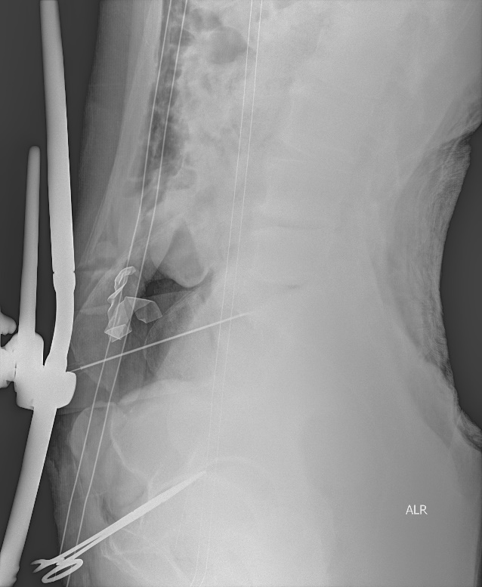
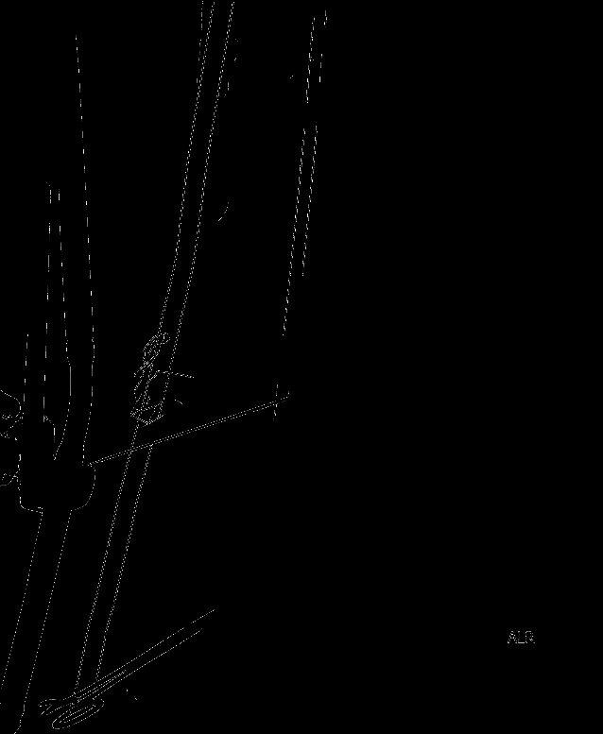
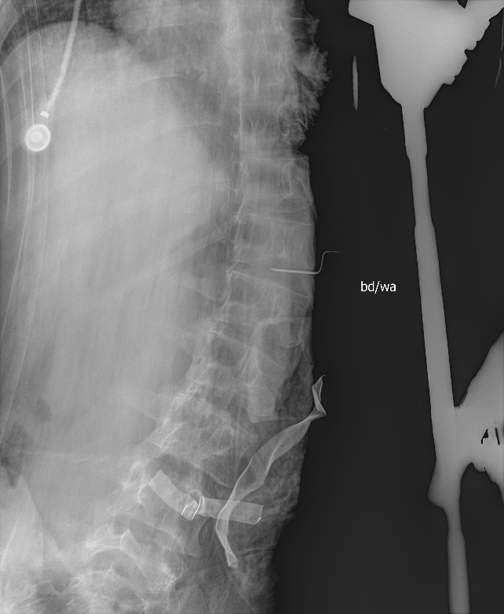
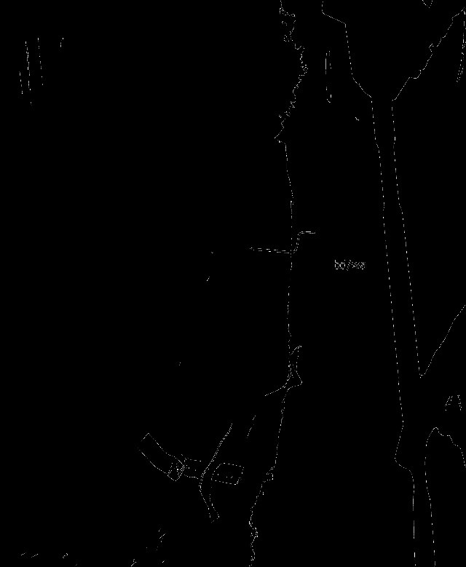
Canny Edge Detector

Slide 14
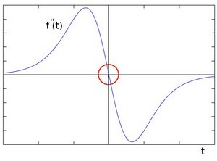
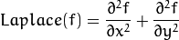





Laplacian Operator
Edge is determined by second derivative of intensity
Output image is calculated by summing x and y derivatives

Slide 15
Research Methods
Phase 2
Feature extraction
Scale-Invariant Feature Transform (SIFT)
Allow scaling
Invariance to image rotation
Slow
Speeded-Up Robust Features (SURF)
A faster version of SIFT
Allow image rotation
Notes:
In phase 2, I extracted features and match them with ground truth.
I used SURF feature detector because it is scale invariant and it will be crucial to this project.
I apply SURF detector on all images I have, the ground truth, x-ray scans.
And then the feature key points are fed into the description extractor. This will gave me descriptor that I can use to match between two images.
FlannBasedMatcher are used to match descriptors from both ground truth and x-ray scans. Flann is a fast nearest neighbor search and it is used for large features like this.
The matches will be outputted to a match array and good matches are extracted for visual verification.

Slide 16



Research Methods
Phase 2
Feature extraction
Speeded-Up Robust Features (SURF)

Slide 17


Research Methods
Phase 2
Feature extraction
Scale-Invariant Feature Transform (SIFT)

Slide 18
Research Methods
Phase 2
Feature extraction (SURF | SIFT)
Feature Detector
Detect Ground Truth, False/Positive cases, Test cases
Produce key points.
Description Extractor
Extractor descriptors from key points.
FlannBasedMatcher
Match descriptors with ground truth
Mark good matches and bad matches.
Feed training matrix into machine learning
Ground Truth
Detector
Key Points
Extractor
Matches
Descriptors
FlannBased Matcher
T/F Case
Detector
Key Points
Extractor
Notes:
In phase 2, I extracted the feature and match them with ground truth.
I used SURF feature detector because it is scale invariant and it will be crucial to this project.
I apply SURF detector on all images I have, the ground truth, x-ray scans.
And then the feature key points are fed into the description extractor. This will gave me descriptor that I can use to match between two images.
FlannBasedMatcher are used to match descriptors from both ground truth and x-ray scans. Flann is a fast nearest neighbor search and it is used for large features like this.
The matches will be outputted to a match array and good matches are extracted for visual verification.

Slide 19






Research Methods
Phase 2
Feature extraction (SURF | SIFT)
3 input image formats are used
Original (Blurred)
Canny
Laplacian
Original
Input Images
Image-Preprocessing
Canny
Ground Truth
Laplacian
Notes:
In phase 2, I extracted the feature and match them with ground truth.
I used SURF feature detector because it is scale invariant and it will be crucial to this project.
I apply SURF detector on all images I have, the ground truth, x-ray scans.
And then the feature key points are fed into the description extractor. This will gave me descriptor that I can use to match between two images.
FlannBasedMatcher are used to match descriptors from both ground truth and x-ray scans. Flann is a fast nearest neighbor search and it is used for large features like this.
The matches will be outputted to a match array and good matches are extracted for visual verification.

Slide 20
Research Methods
Phase 3
Training Support Vector Machine (SVM)
Create training matrix
Match ground truths with true cases and false cases
4000-20000 features
Create label matrix
Parse filename for labels
Files start with ‘x’ indicate false case (0), push back 0
Otherwise, it is true case, push back 1
Train the program
Feed training and label vectors into SVM.
Notes:
To apply this for machine learning, I created a feature matrix from our matcher.
For different contrast, blur strength, I got different size of features.
A label matrix is also created by parsing filename.

Slide 21
Research Methods
Phase 3
Model Verification
Provided 184 true cases and 92 false cases
48 true cases used as ground truth
228 images used as initial testing set
However, it took 3 hours to complete
Reduce testing set
Randomly select 25 true cases and 25 false cases.
Each run took about 30 minutes
Ran test with SURF, SIFT
On All formats
Original Image
Canny Edge Detect
Laplacian
Record accuracy, sensitivity, specificity
Save model for future use
Notes:
To apply this for machine learning, I created a feature matrix from our matcher.
For different contrast, blur strength, I got different size of features.
A label matrix is also created by parsing filename.

Slide 22
Result - SVM
 | Sensitivity | Specificity | Accuracy
Original - SURF | 0.44 | 0.88 | 0.66
Original - SIFT | 0.12 | 0.80 | 0.46
Canny – SURF | 0.84 | 0.68 | 0.76
Canny – SIFT | 0.92 | 0.60 | 0.76
Laplacian – SURF | 0.32 | 0.52 | 0.42
Laplacian - SIFT | 0.40 | 0.72 | 0.56

Slide 23
Possible Improvements
Adjust image pre-processing parameters
Contrast, brightness can greatly affect result
Optimize feature extraction parameters
blur strength
canny threshold
Laplacian depth
descriptor matching threshold

Slide 24
Reference
[1] Tips for reducing retained surgical items. Same-Day Surgery, September 2009; 91-92
[2] Retained surgical item identification on imaging studies: a training module for radiology residents. International Journal of Computer Assisted Radiology and Surgery, November 2015; 1803-09
[3] Retained Surgical Items and Minimally Invasive Surgery, World J Surg., July 2011; 1532-39
[4] Retained Surgical sponges, needles and instruments, Ann R Coll. Surg. Engl., March 2013; 87-92
[5] Imaging of Surgical Paraphernalia: What Belongs in the Patient and What Does Not, Radiographics, November 2000; 1665-73
[6] Pixel-Based Machine Learning in Medical Imaging, International Journal of Biomedical Imaging, 2012; 18 pages

